Slide 1
SMART IRRIGATION
-Dr. JOTHILAKSHMI (Mentor)
- RITHIKAA K
- RADHA G
- PAVITHRA S
- MAHALAKSHMI M M

Slide 2
OBJECTIVE
The project presents the use of soil moisture sensors which helps to ease out the difficulty to monitor and keep record about the changes in soil moisture. Using the NodeMcu with a moisture sensor, temperature and humidity sensor, soil condition is measured and analyzed. The sensors provide information related to the moisture status of the soil. The NodeMcu will collect and process the data received from the Sensors. When a threshold moisture level of the soil is reached, the water will supply accordingly. This is essential because water must be provided to the plant at a particular time for a good yield. This project is highly useful for farmers, Nursery professionals by eradicating traditional or manual methods of irrigation systems.

Slide 3
BLOCK DIAGRAM :
POWER SUPPLY
AR
Moisture Sensor
NODEMCU
Motor ON/OFF
DHT11

Slide 4
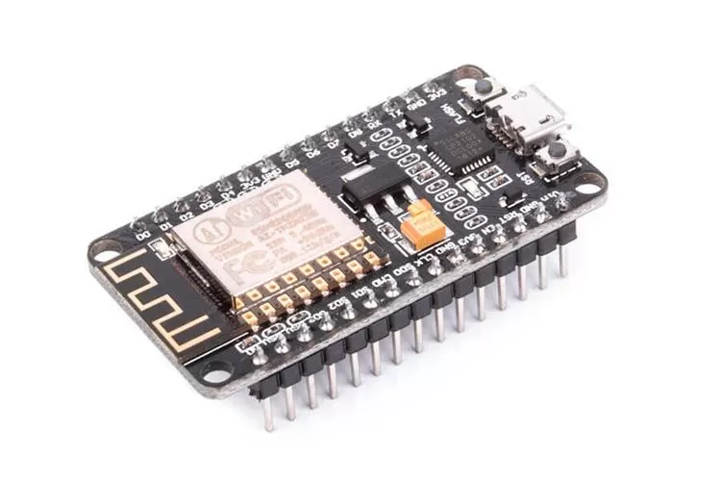
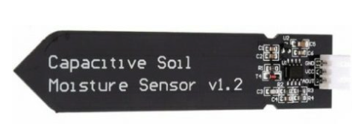
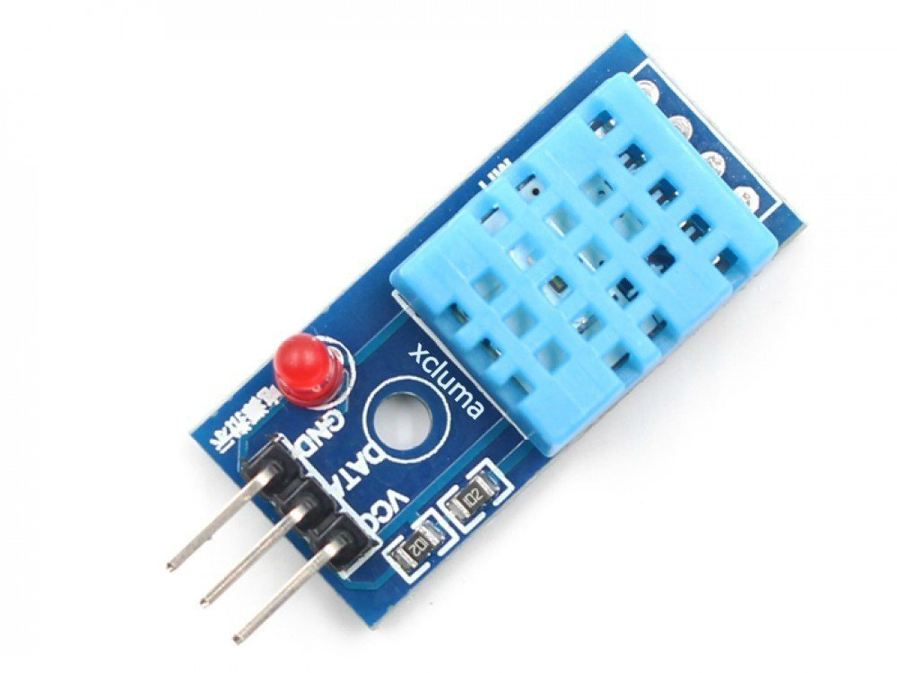
NODE MCU:
NodeMCU is a low-cost open source IoT platform. It initially included firmware which runs on the ESP8266 Wi-Fi SoC from Espressif Systems, and hardware which was based on the ESP-12 module.
MOISTURE SENSOR:
This is an analog capacitive soil moisture sensor which measures soil moisture levels by capacitive sensing. This means the capacitance is varied on the basis of water content present in the soil. You can convert the capacitance into voltage level basically from 1.2V minimum to 3.0V maximum. The advantage of Capacitive Soil Moisture Sensor is that they are made of a corrosion-resistant material giving it a long service life.
DHT11:
The DHT11 is a basic, ultra low-cost digital temperature and humidity sensor. It uses a capacitive humidity sensor and a thermistor to measure the surrounding air. It gives a digital signal on the data pin.

Slide 5
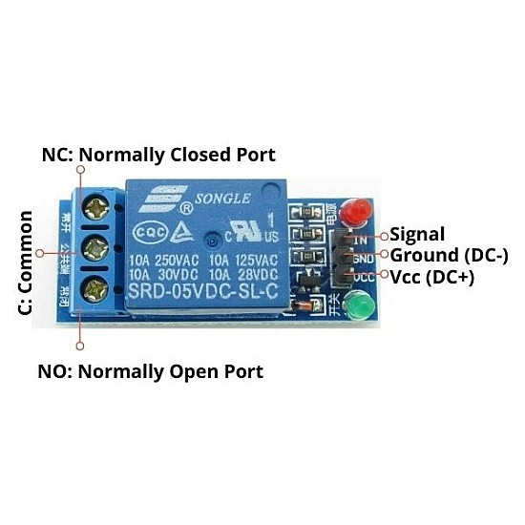
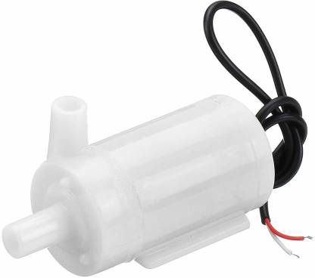
RELAY:
Relay is one kind of electro-mechanical component that functions as a switch. The relay coil is energized by DC so that contact switches can be opened or closed. A single channel 5V relay module generally includes a coil, and two contacts like normally open (NO) and normally closed (NC).
Water Pump:
The Water Pump is a low-cost, small-size Submersible Pump Motor. It operates from a 2.5 ~ 6V power supply. It can take up to 120 liters per hour with a very low current consumption of 220mA. Just connect the tube pipe to the motor outlet, submerge it in water, and power it.

Slide 6
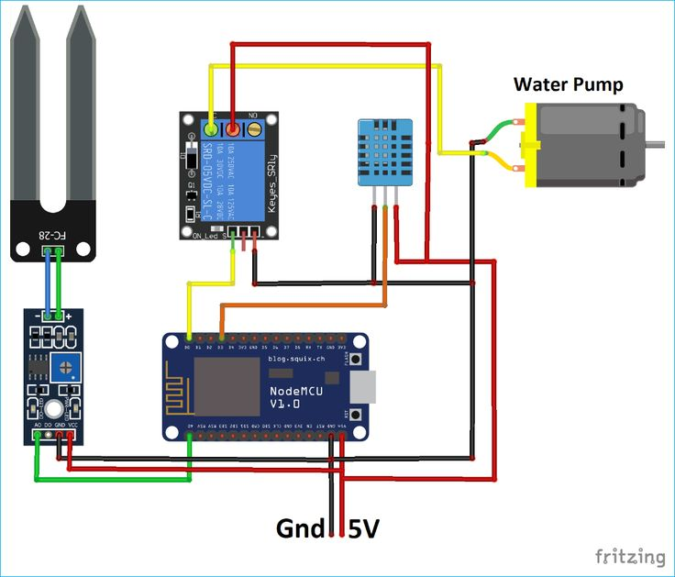
SCHEMATIC DIAGRAM

Slide 7
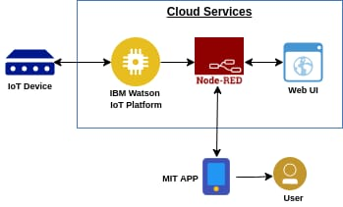
SOLUTION

Slide 8
REFERENCES
Shradha Verma, Anshul Bhatia, Anuradha Chug and Amit Prakash Singh, “Recent Advancements in Multimedia Big Data Computing for IoT Applications in Precision Agriculture: Opportunities”, Multimedia Big Data Computing for IoT Applications: Concepts, Paradigms and Solutions, Volume 163, pp 391-416, Springer Nature Singapore Pte Ltd. 2020
Cloud and IoT based smart architecture for desalination water treatment: Mohammed Alshehri, Ph.D., Akashdeep Bhardwaj, Manoj Kumar, Ph.D., Shailendra Mishra,Jayadev Gyani https://doi.org/10.1016/j.envres.2021.110812/ Â© 2021 Elsevier Inc. All rights reserved.
Full smart sprinklers: Monitoring of sprinkler watering using IoT:M.V.B.T. Santhi, S. Hrushikesava Raju, P. Seetha Rama Krishna, AshokKoujalagihttps://doi.org/10.1016/j.matpr.2020.12.399/Â©2021 Elsevier Ltd. All rights reserved.

Slide 9
THANK YOU

